Slide 1
Certifying the CWB
Notes:
This is the fifteenth presentation in the 18-part series for CWB training. The following slides cover how to complete the CWB process by validating and certifying the data in the CWB tool.

Slide 2
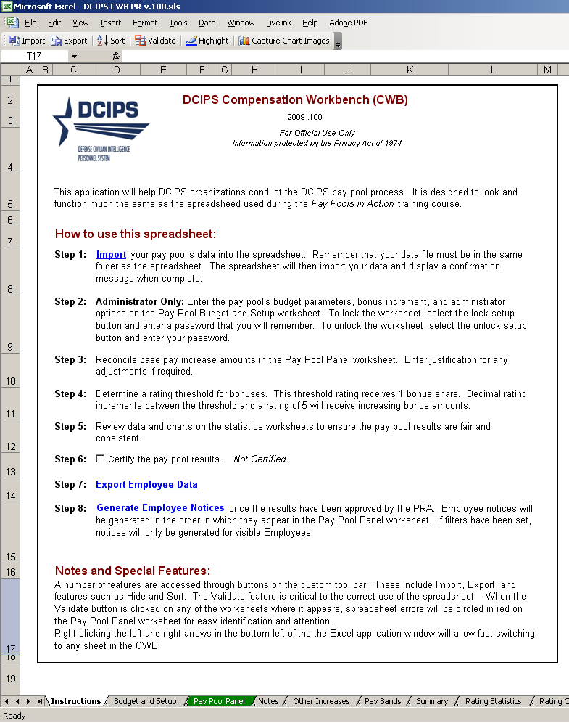
Completing the Process
Step 6 – Certify the Pay Pool Results -- certify after the pay pool results are final
Step 7 – Export Employee Data – export your data only after approval by the PRA. This creates the upload file that flows back into your DCPDS
Step 8 – Generate Employee Notices – generate only after PRA approval
Notes:
This slide shows the final three steps for certifying the pay pool results, exporting data, and generating employee notices.

Slide 3
Certification
Notes:
Finishing the process – certifying results. Spreadsheet is not certified right now.

Slide 4
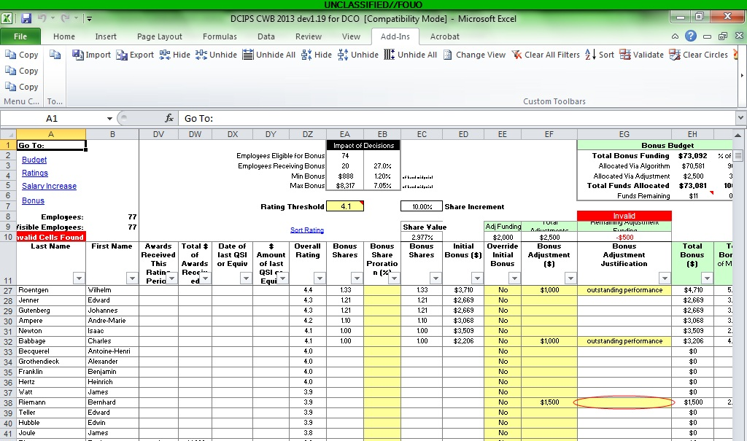
Validate & Clear
Notes:
The Validation button looks for some internal inconsistencies such as not including a justification for an adjustment. Correct the error and hit Clear Circles or Dialog Box to continue.

Slide 5
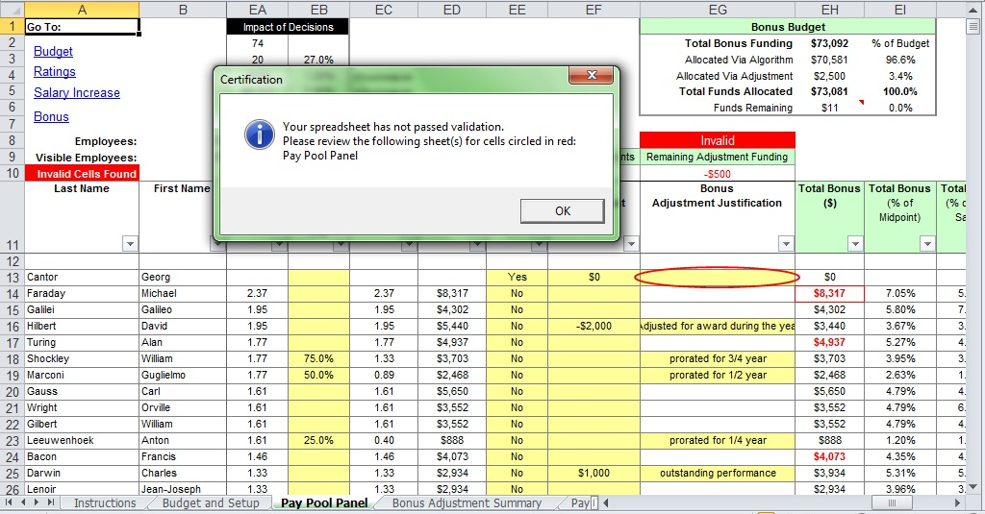
Certifying -> Validation
Notes:
Certifying checks the same things validation does, and indicates if there are errors that should be fixed.
You can export to the DPAT without certifying.

Slide 6
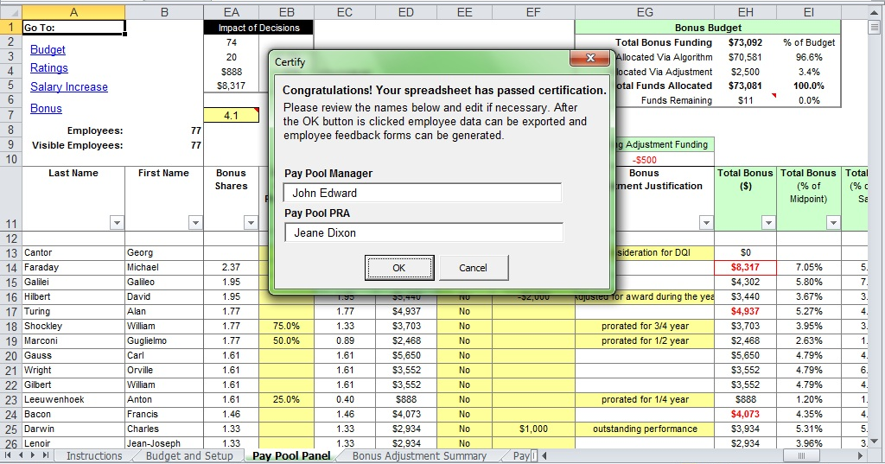
Certification Ready
Notes:
Spreadsheet passes certification. You can alter the names of the PPM and PP PRA if needed; these values will print on the employee feedback forms.

Slide 7
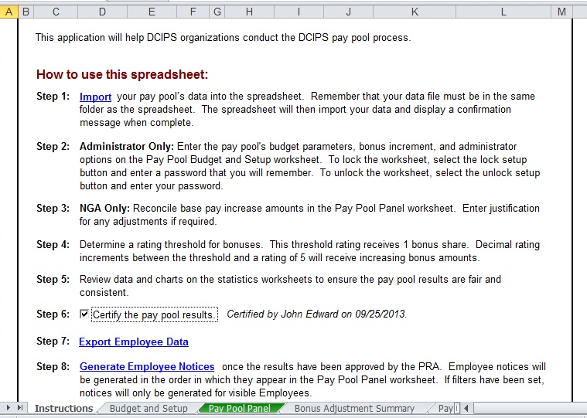
Certification
Notes:
Certification date is noted. You can uncertify and recertify if needed. Must be certified to export results to upload to DCPDS.

Slide 8
To continue CWB training, view next presentation
“Exporting CWB Data”
Notes:
This concludes the fifteenth presentation in the 18-part series for CWB training. To continue training, view the next Presentation, entitled Exporting CWB Data.

